Slide 1

salary and Compensation Analysis through Excel data Modeling
STUDENT NAME: SANJANA M
REGISTER NO: 312217051 (asunm1659312217051)
DEPARTMENT: BCOM (GENERAL)
COLLEGE : SHRI KRISHNASWAMY COLLEGE FOR WOMEN
1
Notes:
1

Slide 2

PROJECT TITLE
SALARY AND COMPENSATION ANALYSIS THROUGH EXCEL DATA MODELING
2

Slide 3



AGENDA
Problem Statement
Project Overview
End Users
Our Solution and Proposition
Dataset Description
Modelling Approach
Results and Discussion
Conclusion
3/21/2024 Annual Review
3

Slide 4


PROBLEM STATEMENT
Salary discrepancies across roles and locations.
Ensuring competitive compensation.
Addressing pay equity and bias.
Weak link between performance and salary adjustments.
Balancing salary increases with budget constraints.
Compliance with labour laws and regulations.
Offering meaningful benefits.
4

Slide 5

PROJECT OVERVIEW
Base Salary: Fixed pay.
Bonuses: Performance-based
enefits: Health, retirement, PTO.
Equity: Stock options/RSUs.
Perks: Flexible work, development.
Benchmarking: Industry/location comparison.
Equity: Fair pay, transparency.
Compliance: Wage laws, equal pay.
Performanc: Pay tied to reviews.
Total Compensation: Holistic rewards.
.
5

Slide 6

WHO ARE THE END USERS?
HR: Structure pay.
Analysts: Adjust compensation.
anagers Recommend salaries.
Finance: Manage budgets.
Executives: Align with strategy.
Employees: Receive compensation.
Recruiters: Offer salaries.
Legal: Ensure compliance.
6

Slide 7
OUR SOLUTION AND ITS VALUE PROPOSITION
Competitive Pay: Market-aligned salaries.
Data Insights: Informed decisions.
Custom Plans: Tailored compensation.
Fair Pay: Internal equity.
Compliance: Legal adherence.
Efficiency: Automated processes.
Engagement: Boost retention.
7

Slide 8
Dataset Description
Employee Info: Job titles, location, tenure.
Salary: Base pay, bonuses, commissions.
Benefits: Health, retirement, PTO.
Performance: Ratings, targets.
Market Data: Industry and location benchmarks.
Equity: Stock options, RSUs.
Demographics: Age, gender, experience.
Compliance: Wage laws, tax data.

Slide 9

THE "WOW" IN OUR SOLUTION
Real-Time Data: Instant access to up-to-date compensation insights.
Customizable Dashboards: Tailored views for different user needs.
AI-Driven Recommendations: Automated, smart salary adjustments.
Seamless Integration: Syncs with HR systems for easy implementation.
Advanced Analytics: Predictive models for future compensation trends.
Transparency & Equity: Ensures fairness across the organisation.
3/21/2024 Annual Review
9

Slide 10
MODELLING
Compensation Structures: Designing pay grades and bands.
Benchmarking Models: Comparing internal pay against market data.
Equity Models: Ensuring fair pay across roles and demographics.
Performance-Based Pay: Linking compensation to performance metrics.
Predictive Analytics: Forecasting future salary trends and budget impacts.
Scenario Analysis: Evaluating effects of changes in compensation strategy.
10

Slide 11
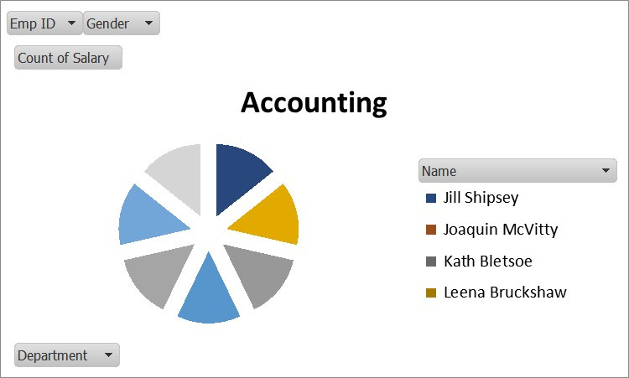
RESULTS
11

Slide 12
conclusion
The conclusion should summarise how the organisation's salaries compare to market rates and internal equity, highlight any compensation gaps, and recommend adjustments to improve fairness and alignment with strategic goals.

